Slide 1


Tổng quan hệ thống Core Trading VPS

Slide 2
Phân hệ Người dùng
Khách hàng
Giao dịch chứng khoán cơ sở, phái sinh
Quản lý tài khoản, danh mục,…
Môi giới
Quản lý và đặt lệnh cho khách hàng
Tổng hợp thống kê
Nghiệp vụ:
DVKH, DVTC, KT, KSRR …
Thực hiện tất cả các nghiệp vụ về BackOffice và Front Office

Slide 3
Phân hệ Người dùng
Khách hàng
SmartOne Web (WebTrading)
SmartOne Mobile
SmartPro Web (HomeTrading)
SmartPro MB
Bảng giá
Môi giới
BD
Nghiệp vụ:
Back Office
BD
FRONT-OFFICE
BACK-OFFICE

Slide 4
Back-Office
Core Nghiệp Vụ
Database Oracle
Toàn bộ dữ liệu của hệ thống
Trừ dữ liệu về trading trong ngày
Nghiệp vụ
Stored Procedures
Xử lý tất cả các nghiệp vụ của hệ thống
Trừ nghiệp vụ trading

Slide 5


Back-Office
(Mô hình hệ thống)
Back Office Users
VSD GW
WEB BO
Rest API
Vietin GW
FRONT-OFFICE SYSTEM
Rest API
Customer
VPBank GW
Rest API

Slide 6
Front-Office
Oracle TimesTen: Core giao dịch
NFO: Core Message
Gateway: Internal-Gateway, ExternalGW
Middle Server: Mid-BD, HomeTrade, WebTrade.
Channel: WebTrade Client, HomeTrade Client, Mobile, BD
InfoGate, DataFeed, Bảng giá
TimesTen
Notes:
Oracle TimesTen In-Memory Database is a full-featured, memory-optimized, relational database that delivers microsecond response and extremely high throughput performance for mission critical applications in a wide range of industries.

Slide 7
Front-Office
(Core giao dịch)
Oracle TimesTen In-Memory Database
Dữ liệu khách hàng, broker phục vụ cho Trading: Account, Product, Cash, Share,…
Dữ liệu Trading: Order, Deal, block Ký quỹ,…
Dữ liệu thị trường, cổ phiếu
Nghiệp vụ
Stored Procedures
Xử lý các nghiệp vụ Trading
Quản trị tài khoản, danh mục,…
Quản trị rủi ro
TimesTen
Notes:
Oracle TimesTen In-Memory Database is a full-featured, memory-optimized, relational database that delivers microsecond response and extremely high throughput performance for mission critical applications in a wide range of industries.

Slide 8
Sync BO-FO
Đồng bộ từ BO -> FO
Dữ liệu trên FO là dữ liệu trong ngày, bị clear khi sang ngày GD mới
Đồng bộ Full Data đầu ngày
Đồng bộ real-time
Đồng bộ từ FO -> BO
Đồng bộ real-time trong phiên: Deal, Symbol, SMS Call/Force
Đồng bộ toàn bộ dữ liệu giao dịch khi kết thúc phiên cuối

Slide 9

Sync BO-FO-Kafka
diMaster (Java): Đồng bộ
Đồng bộ theo event: Database Change Notification.
Đồng bộ trực tiếp qua API
SyncMaster, BoDataSync (java):
Đồng bộ real-time trong phiên: Deal, Symbol, SMS Call/Force theo cơ chế event XLA, và đẩy vào Kafka
Kafka -> BoDataSync -> Oracle
EventBus: Order, Session Authen
Kafka: OpenSource
TimesTen Master
diMaster
BO DataSync
SyncMaster

Slide 10
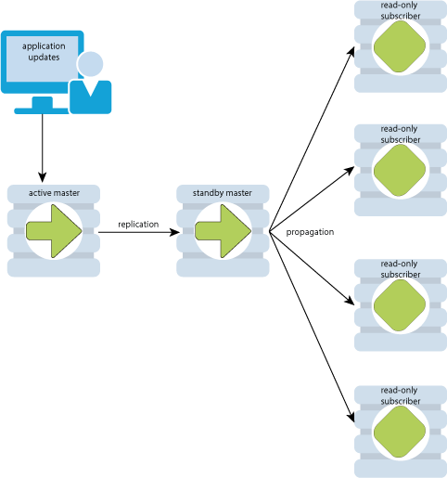
Active standby subcriber

Slide 11
Front-Office
(Core message)
NFO (Java):
Handler Logon, Authen
Handler message Lệnh
Handler message Oracle: 8+ connection
Handler message query TimesTen: 8+ connection
Handler OTP/SMS
Handler Router Gateway
Handler EventBus
HTTP/TCPIP API Hander
Trên cùng 1 máy với 1 node TimesTen Sub
NFO
BD,WT, HT Client
Middle
Socket Client
Socket Server
HT Service
Rest API
Rest API
TimesTen Sub
WT Service
Rest API
Other Service
TimesTen Master
Notes:
An application can create a direct connection when it runs on the same machine as the TimesTen database. In a direct connection, the ODBC driver directly loads the TimesTen database into a shared memory region. The application then uses the direct driver to access the memory image of the database. Because no inter-process communication (IPC) of any kind is required, a direct connection provides extremely fast performance and is the preferred way for applications to access the TimesTen database.

Slide 12
Front-Office
(Middle)
Middle-BD (Java):
Server Socket cho BD Client
Client Socket nối với NFO cho Trading message
Xử lý Real-time Order và Push về BD
HomeTrade Server (Java)
Vert.X handler
EventBus: Order, Session Authen
Handler Rest API tới NFO
WebTrade Server (ASP.NET, C#)
Proxy cho WebTrade client, SmartOne.
Etc.
NFO
BD,WT, HT Client
Middle
Socket Client
Socket Server
HT Service
Rest API
Rest API
TimesTen Sub
WT Service
Rest API
Other Service
TimesTen Master
Notes:
An application can create a direct connection when it runs on the same machine as the TimesTen database. In a direct connection, the ODBC driver directly loads the TimesTen database into a shared memory region. The application then uses the direct driver to access the memory image of the database. Because no inter-process communication (IPC) of any kind is required, a direct connection provides extremely fast performance and is the preferred way for applications to access the TimesTen database.

Slide 13
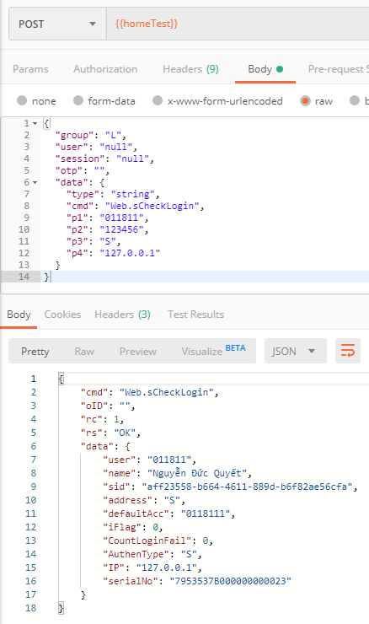
Front-Office
(Core message)
API Format
EndPoint Chung.
Cấu trúc chuẩn chung cho hệ thống
Linh hoạt cho việc phát triển, tích hợp
Group message
Message Lệnh.
Message query TimesTen
Message query, execute BO
Notes:
An application can create a direct connection when it runs on the same machine as the TimesTen database. In a direct connection, the ODBC driver directly loads the TimesTen database into a shared memory region. The application then uses the direct driver to access the memory image of the database. Because no inter-process communication (IPC) of any kind is required, a direct connection provides extremely fast performance and is the preferred way for applications to access the TimesTen database.

Slide 14


Front-Office
(Gateway Trading)
NFO
Broker Desk (BD)
Socket Server
Middle
Socket Client
Socket Server
Socket Client
Socket Server
Internal GW HNX
Socket Client
FIX
Socket Server
HNX GW
Socket Client
HomeTrade
HT Service
Rest API
Rest API
TimesTen Sub
WebTrade
Socket Server
Internal GW PS
Socket Client
FIX
Socket Server
HNX GW PS
Socket Client
WT Service
Rest API
Socket Server
Internal GW HSX
Socket Client
FIX
Socket Server
Socket Client TCP
TimesTen Master
HSX GW
UDP
GW Market
Socket Client
TCP

Slide 15
Front-Office
(Gateway Trading)
Gateway Trading kết nối các sở
GW Phái Sinh: QuickFix 4.4 (Protocol chuẩn FIX)
GW Cơ Sở HNX: QuickFix 4.4 (Theo giao thức riêng HNX)
GW Cơ Sở HoSE: AutoT (CTCI, PRS)
Đặc điểm chính
Client-Server trên nền TCP/IP
Đường truyền riêng kết nối với sở
Đảm bảo tuyệt đối: ổn định, real-time, không bị mất package trên đường truyền.
Đảm bảo recover, failover

Slide 16
Front-Office
(Real-Time)
Message Real-time
Order, SMS Call/Force Sell,
Asset, Account Status, Deal
Công nghệ
XLA của TimesTen
Hazelcast: Open source in-memory data grid based on Java.
Kafka: Open-source stream-processing software platform
TimesTen Master
Gateway Trading
BO DataSync
SyncMaster
NFO Group
Middle
HomeTrade
Other
Redis-DataFeed
Notes:
XLA and TimesTen Event Management
The TimesTen Transaction Log API (XLA) is a set of C language functions that enable you to implement applications to perform the following:
Monitor TimesTen for changes to specified tables in a local database.
Receive real-time notification of these changes.
The primary purpose of XLA is as a high-performance, asynchronous alternative to triggers.
- Producer API – Permits an application to publish streams of records.
- Consumer API – Permits an application to subscribe to topics and processes streams of records.

Slide 17
Front-Office
(Scale & Load balance)
F5
HT Service
NFO
Rest API
Internal Gateway
HT Service
TimesTen Sub
TimesTen Master
HomeTrade Client
HT Service
Rest API
NFO
WebTrade Client
WT Service
Rest API
Rest API
WT Service
TimesTen Sub
WT Service
NFO
Rest API
Broker Desk (BD)
Middle
TimesTen Sub

Slide 18

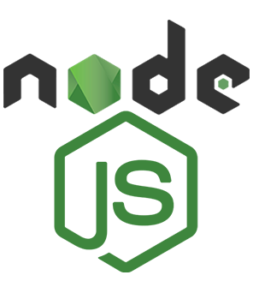
Market - DataFeed
TimesTen Master
diMaster
Socket Server
Infogate PS
Socket Client
Socket Client
Socket Client
SyncMaster
Socket Server
Infogate NY
Socket Client
Shared Files
PRS
Socket Client
Redis-Price
Redis Master
External Services
Socket Client
Socket Client
PriceBoard PS
PriceBoard NY
Redis Slave
Redis Slave
Redis Slave
Rest API & WebSocket
Rest API & WebSocket
Rest API
Socket.io Server
Rest API
Socket.io Server
Rest API
Socket.io Server
BD (Bảng giá)
SmartOne (Bảng giá)
SmartPro (Bảng giá)
HomeTrade (Bảng giá)
WebTrade (Bảng giá)

Slide 19

THANK YOU!

